Slide 1


SMART DOC CHECKER
SCAN. FLAG. FIX.

Slide 2


PROBLEMS FACED:
  CONTRADICTIONS ACROSS DOCUMENTS: E.G., HR POLICY SAYS 30 DAYS LEAVE, ANOTHER SAYS 24.
  OVERLAPPING OR REDUNDANT CLAUSES: MULTIPLE DOCUMENTS REPEATING SIMILAR RULES.
  OUTDATED POLICIES: NO VISIBILITY INTO WHICH VERSION IS CURRENT.
  MANUAL REVIEW BOTTLENECKS: TEAMS WASTE HOURS CROSS-CHECKING DOCUMENTS.
SMART DOC CHECKER

Slide 3


OUR SOLUTION:
OUR Smart Doc Checker Agent will:
  AUTOMATED COMPLIANCE AUDIT: INGEST ALL POLICY FILES (RETENTION SCHEDULES, SOPS, REGULATIONS) INTO ONE PLATFORM.
  AI-POWERED ANALYSIS: USES NLP TO ENSURE POLICIES MUTUALLY ALIGN, FLAGS ANY RULE THAT DOES NOT MATCH OTHERS OR EXTERNAL REGULATIONS. AI CAN TRACK LEGAL TEXT CHANGES.
  OUTCOME: AUDITS BECOME FASTER AND LESS ERROR-PRONE. COMPLIANCE TEAMS GET A SINGLE REPORT LISTING ALL INCONSISTENCIES AND THEIR SOURCES.
  VISUAL FLOW: RAW DOCUMENTS → AI ANALYSIS → “COMPLIANCE SCORECARD” OR LIST OF ISSUES WITH CHECKMARKS.
SMART DOC CHECKER

Slide 4
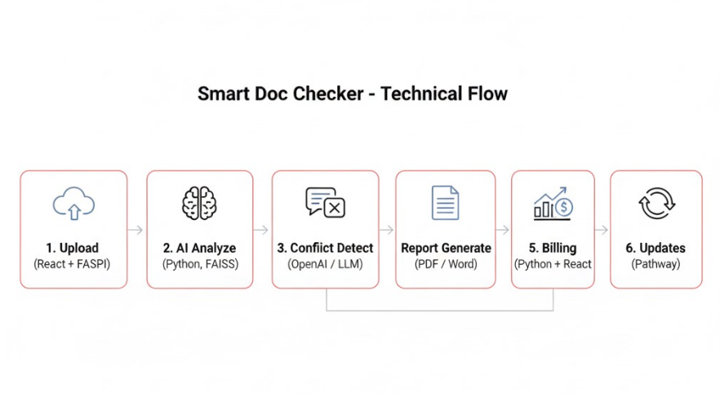
SMART DOC CHECKER

Slide 5


KEY FEATURES:
  MULTI‑DOC UPLOAD: SUPPORT FOR NUMEROUS FILE TYPES; BATCH-UPLOAD ALL RELEVANT POLICIES AT ONCE.
  Conflict Detection Engine: Highlights contradictory clauses or ambiguous terms across docs. (E.g. finds that one policy says “within 3 days” while another says “within 5 days.”)
  Automated Reporting: Generates a concise Conflict Report , summarizing each issue with source context. (Preview mock-up of report page or table.)
  Billing (FlexPrice): Usage-meter measures documents/pages processed; pay-as-you-go pricing incentivizes efficient use. ~15% of modern SaaS use usage-based billing (and 46% a hybrid model).
  Live Update Monitoring (Pathway): Continuously re-scan policies when documents change or regulations update, sending alerts on new conflicts (like an AI compliance watchdog).
  Visual: Icons or small screenshots: e.g. a multi‑upload page, an example conflict highlight (red-highlight text)
SMART DOC CHECKER

Slide 6


BILLING IN SMART DOC CHECKER
IN OUR PROJECT
  Regulatory Demand: Compliance software spend is booming. Organizations need scalable, auditable solutions. By 2026, 70% of companies will vet AI vendor transparency, so trustable AI tools (like ours) will be required
  Revenue Model: Usage pricing lets customers pay exactly for the scope of compliance (wide scan → higher fee; light scan → lower fee). Aligns with CIOs’ preference for agility and pay-per-use.
  Expandability: Can serve finance, healthcare, government, etc. Compliance solutions often achieve high customer retention (see churn stats in SaaS industry).
  Usage Metrics: Large numbers or charts (in Fluent accent color) indicating “Docs Checked: N” and “Credits Spent: M”.
  Pricing Info: Text like “1 document = 1 credit” below counters, using small caption font.
  Visual Elements: Optionally a small bar or pie chart reflecting usage quotas, styled in Fluent colors.
SMART DOC CHECKER

Slide 7
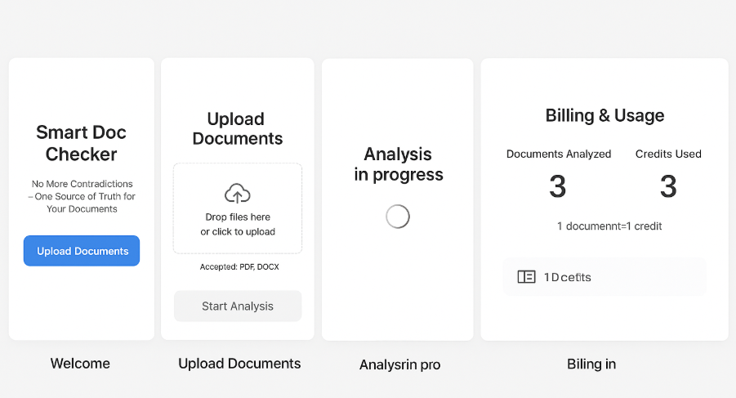
SMART DOC CHECKER UI SLIDE MOCKUP
Upload Documents → AI Analysis → Conflict Detection → Report Generated → Billing & Usage → Pathway Updates
SMART DOC CHECKER

Slide 8
THANK YOU

